Slide 1
PV239 – 02- Design
Roman Jašek, Michal Hazdra
Riganti s.r.o.
roman.jasek@riganti.cz
michal.hazdra@riganti.cz

Slide 2
Goals
Get to know available layouts and controls
Try to create a layout with some controls
Get to know available navigation options
Bonus:
- Styles
- Localization

Slide 3
Controls
Controls
Layouts
Navigation
Styles
Localization
ActivityIndicator
BoxView
Button
DatePicker
Editor
Entry
Image
Label
TimePicker
Slider
OpenGLView
Picker
ProgressBar
SearchBar
Stepper
WebView
TableView
ListView
TextCell
EntryCell
ImageCell
SwitchCell
ViewCell
Map
…

Slide 4
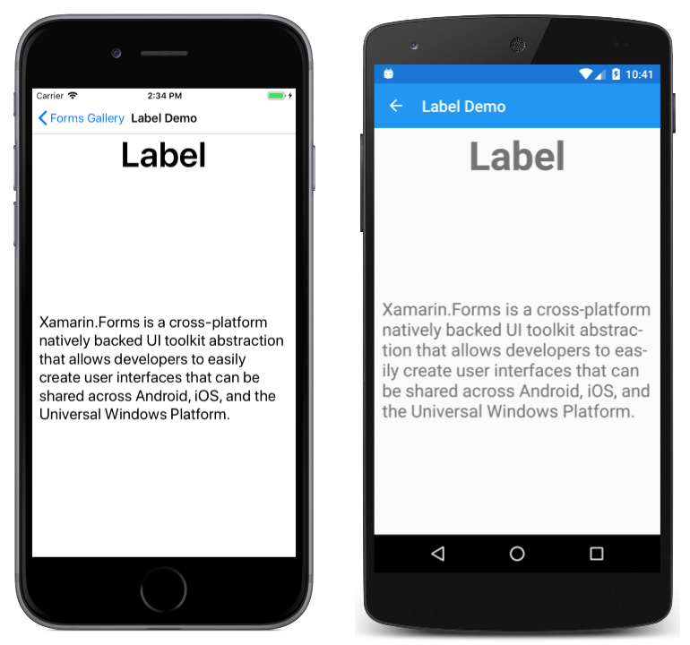
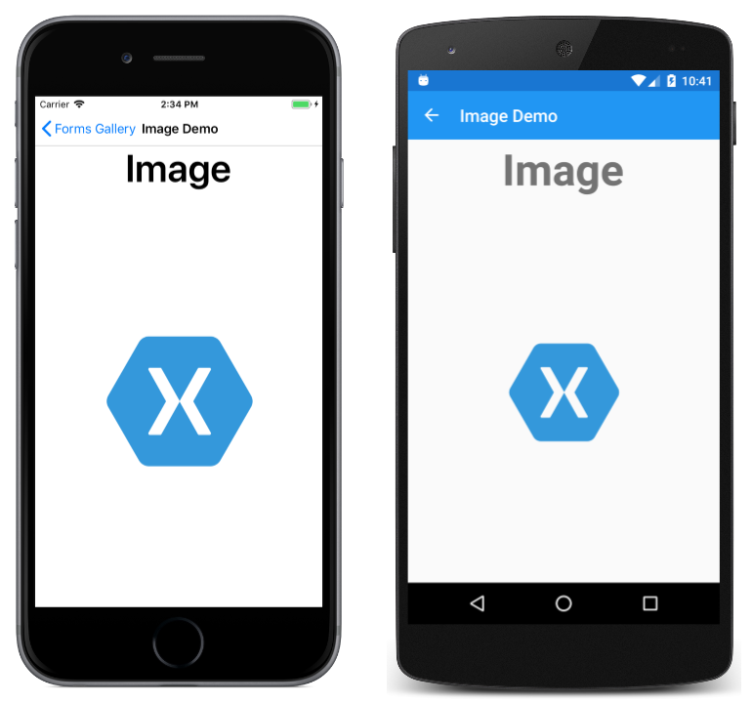
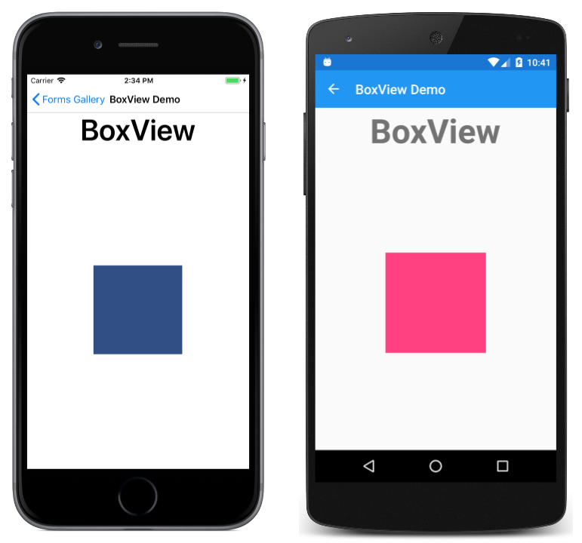
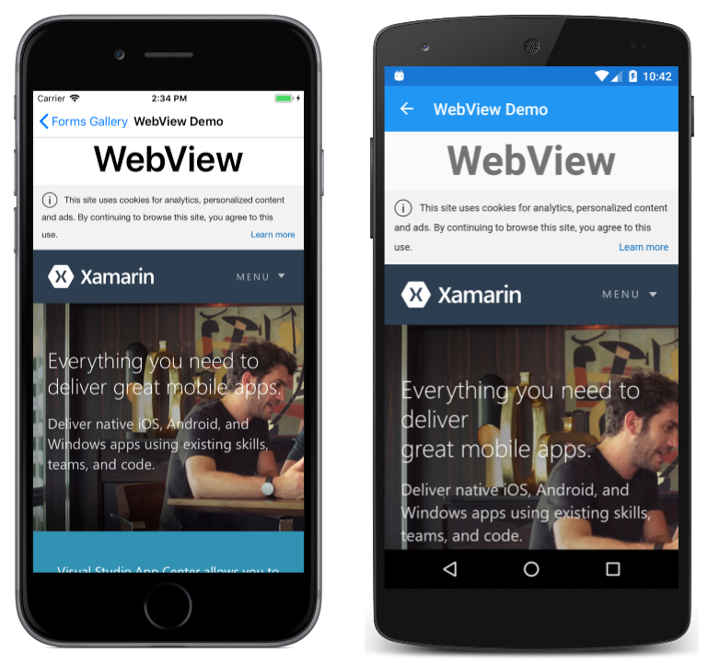
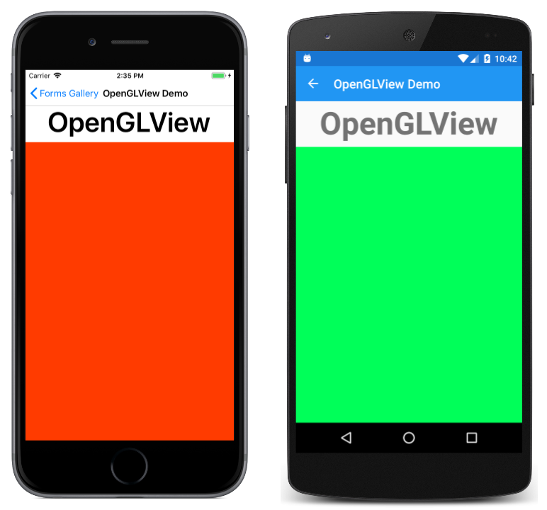
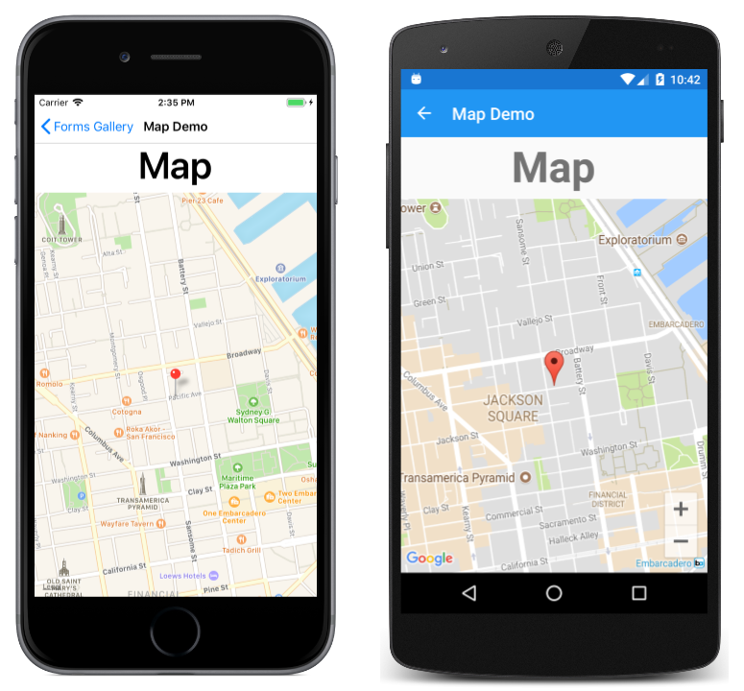
Content Presentation
Controls
Layouts
Navigation
Styles
Localization

Slide 5
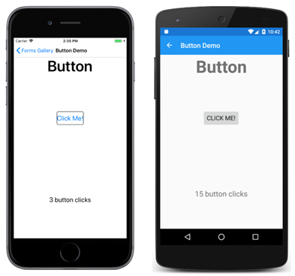
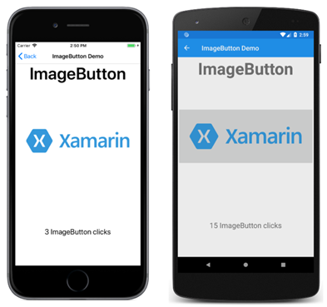
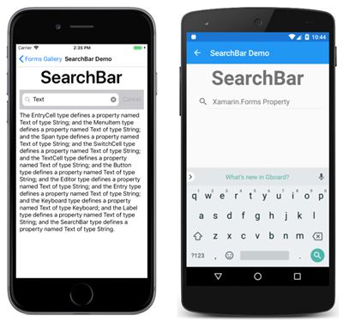
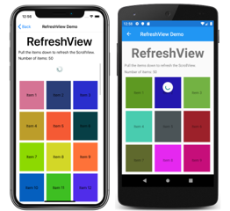
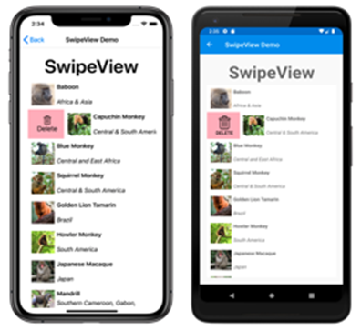
Actionable Controls
Controls
Layouts
Navigation
Styles
Localization

Slide 6
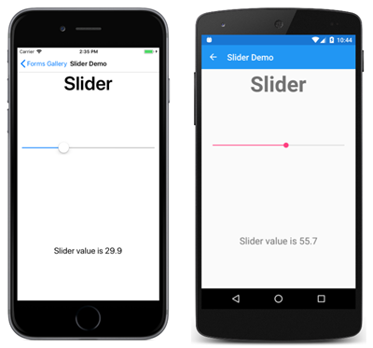
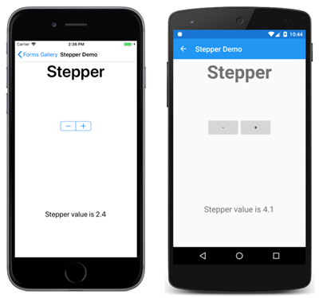

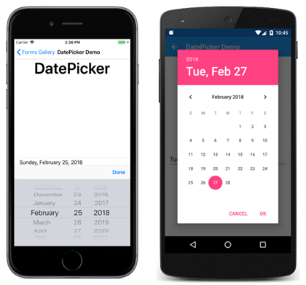
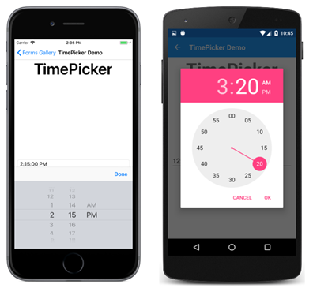
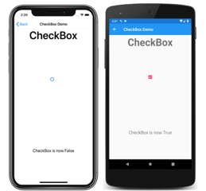
Setting Values
Controls
Layouts
Navigation
Styles
Localization

Slide 7
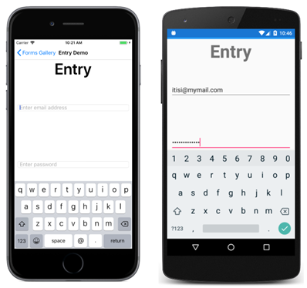
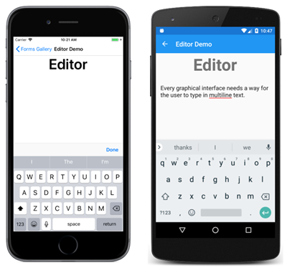
Editing Text
Controls
Layouts
Navigation
Styles
Localization

Slide 8
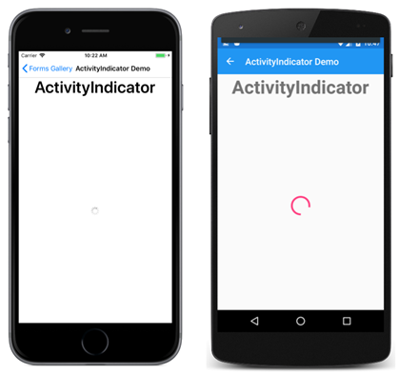
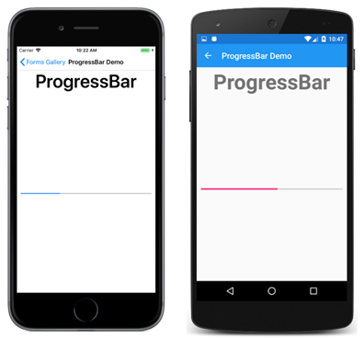
Activity Indication
Controls
Layouts
Navigation
Styles
Localization

Slide 9
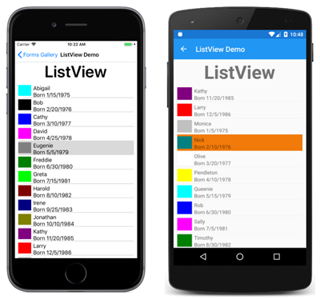
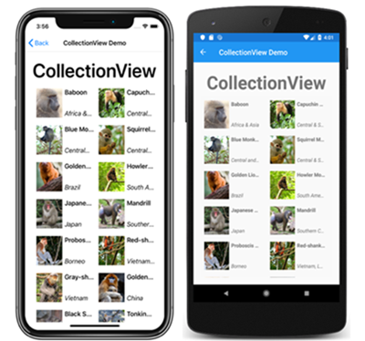
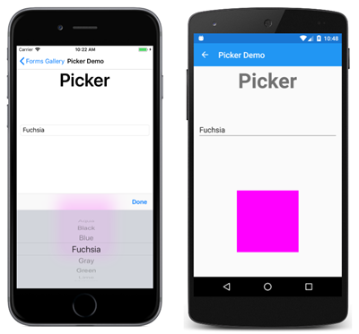
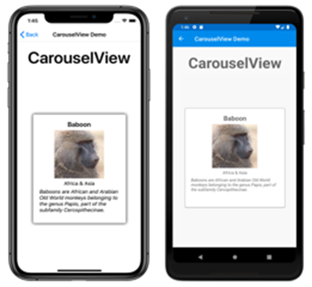
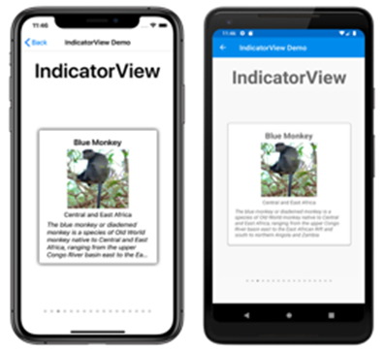
Collections
Controls
Layouts
Navigation
Styles
Localization

Slide 10
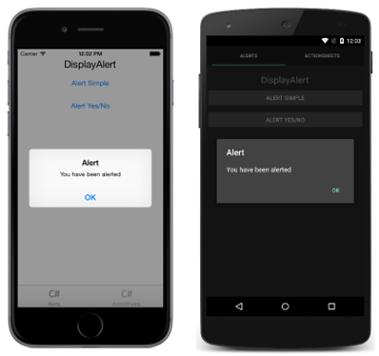
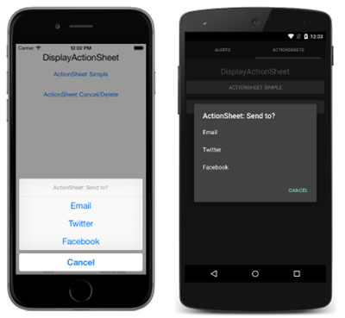
Pop-ups
Controls
Layouts
Navigation
Styles
Localization

Slide 11
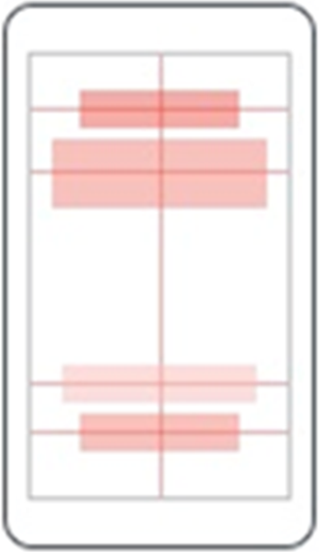
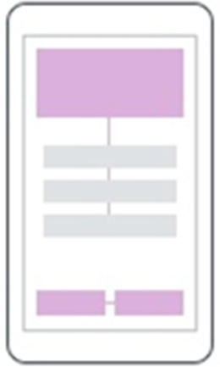
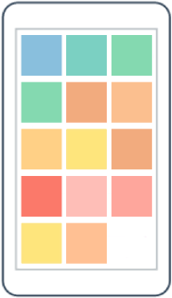
Layouts
Controls
Layouts
Navigation
Styles
Localization
AbsoluteLayout
RelativeLayout
FlexLayout

Slide 12
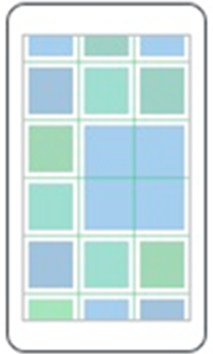
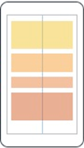
Layouts
Controls
Layouts
Navigation
Styles
Localization
Grid
StackLayout

Slide 13
Grid
Controls
Layouts
Navigation
Styles
Localization
Table-style layout
RowDefinitions, ColumnDefinitions
Width / Height = 150 | * | Auto
Grid.Row, Grid.Column – placement of control in the Grid
Grid.RowSpan, Grid.ColumnSpan – control can span over multiple “cells”
HorizontalSpacing, VerticalSpacing – empty space between “cells”

Slide 14
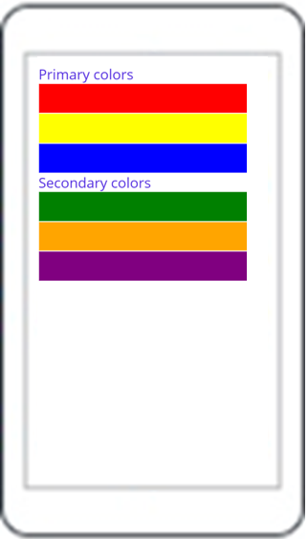
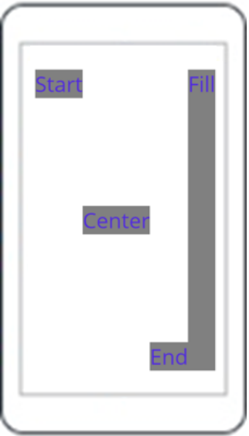
StackLayout
Controls
Layouts
Navigation
Styles
Localization
StackLayout
VerticalStackLayout
HorizontalStackLayout

Slide 15
StackLayout…
Controls
Layouts
Navigation
Styles
Localization
HorizontalStackLayout, VerticalStackLayout
Individual layouts for single direction
Separate LayoutManagers with Measure methods
Recommended (Performance)
StackLayout
Wraps HorizontalStackLayout and VerticalStackLayout
Has Orientation
Useful for adaptive layouts

Slide 16
Layouts
Controls
Layouts
Navigation
Styles
Localization
Demo

Slide 17

Layouts
Controls
Layouts
Navigation
Styles
Localization
Exercise

Slide 18
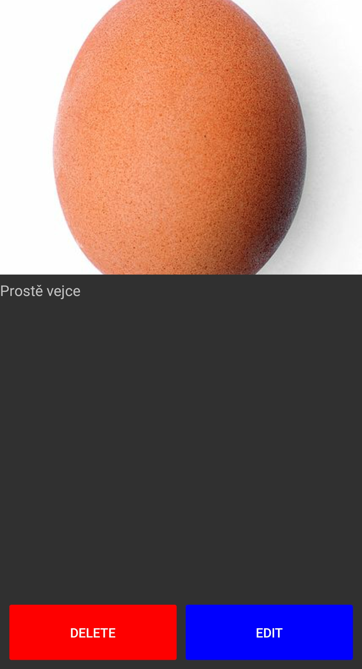
exercise - Layouts
Controls
Layouts
Navigation
Styles
Localization
Grid, Horizontal/VerticalStackLayout
Image, Label, Button

Slide 19
Shell
Controls
Layouts
Navigation
Styles
Localization
Application layout
Navigation using URIs
Hierarchical navigation
Easy passing of parameters between pages
String parameters or strongly typed objects
Works even in backwards navigation “..?success=true”

Slide 20
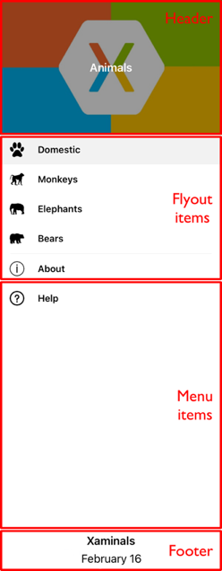
Shell - Flyout
Controls
Layouts
Navigation
Styles
Localization
Header
Items
Footer
Support for text, icons or custom templates

Slide 21
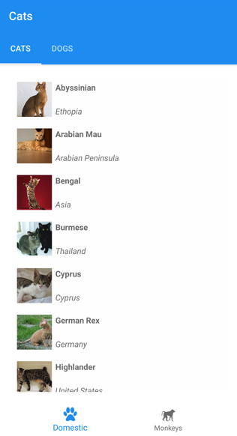
Shell - tabs
Controls
Layouts
Navigation
Styles
Localization
2 levels of hierarchy
Bottom tabs
Top tabs
Support for text, icons, custom templates

Slide 22
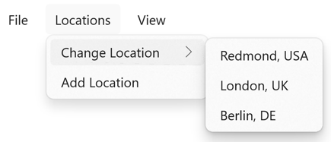
Shell - MenuBar
Controls
Layouts
Navigation
Styles
Localization
MenuBarItem
MenuFlyoutItem
MenuFlyoutSubItem
Support for text, icons

Slide 23
Navigationpage
Controls
Layouts
Navigation
Styles
Localization
NavigationPage
PushAsync
PopAsync

Slide 24
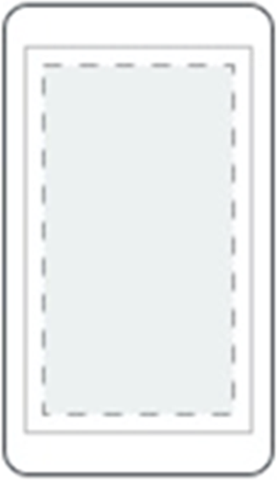
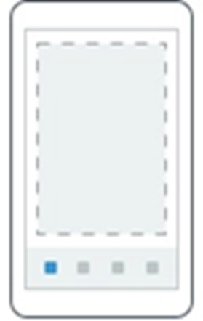

Pages
Controls
Layouts
Navigation
Styles
Localization
ContentPage
Single content
TabbedPage
Tabs
FlyoutPage
Items + detail

Slide 25
Navigation
Controls
Layouts
Navigation
Styles
Localization
Demo

Slide 26
Resources
Controls
Layouts
Navigation
Styles
Localization
Each element contains a collection of Resources
Resources can define any content
Referencing using x:Key
Access with {StaticResource Key}
Can be defined in separate files - merged dictionaries
Hierarchical application
Can be overridden on any level

Slide 27
Styles
Controls
Layouts
Navigation
Styles
Localization
Settign style for a control
TargetType – specifies which element type it should be applied to
x:Key – key of style, can be omitted – in that case it will be automatically applied to all controls of the type
Collection of Setter objects
Property
Value
BasedOn – base style that this style extends – optional

Slide 28
Platform Specific – OnPlatform, OnIdiom
Controls
Layouts
Navigation
Styles
Localization
Useful in XAML
OnPlatform – specify different value for different platforms (Android, iOS, MacCatalyst, Tizen, WinUI)
OnIdiom – specify different value for different idioms (Phone, Tablet, Desktop, TV, Watch)

Slide 29
Styles
Controls
Layouts
Navigation
Styles
Localization
Demo

Slide 30
Text Resources
Controls
Layouts
Navigation
Styles
Localization
.resx files
Separate file for each language mutation
Visual Studio extension – ResXManager – better management of text resources
Set Custom tool for resx file build to PublicResXFileCodeGenerator
Referring to values using {x:Static}

Slide 31
localization
Controls
Layouts
Navigation
Styles
Localization
Demo

Slide 32
Goals
Get to know available layouts and controls
Try to create a layout with some controls
Get to know available navigation options
Bonus:
- Styles
- Localization

Slide 33


